Slide 1

Serious Games
Group 2
Gavaskar Kanagaraj - 509839
Agathiya Raja – 519788
Eric Junior Tchassem Ngounou –
24.06.2020

Slide 2
Idea and Motive
How could people be closer virtually?
Likes and dislikes
Exploring personal interest
How could new people become friends virtually?
Similar area of interest
Sharing ideas

Slide 3
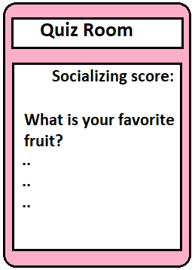
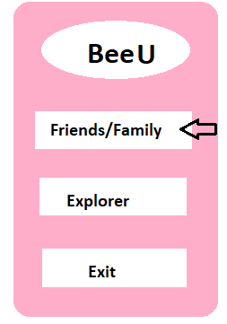
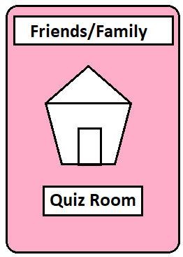
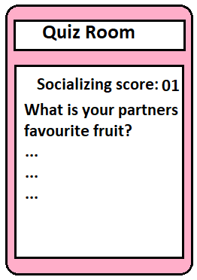
Prototype

Slide 4
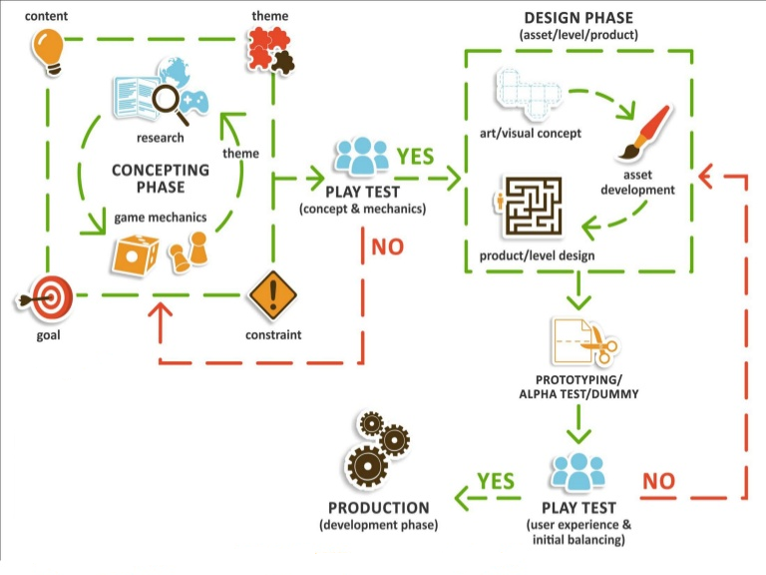
Design Process:

Slide 5
Usage of Lecture content
Intrinsic Motivation
Timer
Operational rules
Implicit rules
Reward system

Slide 6
Evaluation of Game
Survey with people:
Does this game really fun to play?
Is this game interesting to play?
Do you learn each other better?

Slide 7
Thank you

